Slide 1


Job Market Analysis &
Recommendation System
In this project, I developed a Job Market Analysis and Recommender System to identify trending job roles and recommend suitable positions based on user input. I began by collecting and preprocessing job data, standardizing fields like location, experience, and job type. I performed exploratory analysis to uncover patterns in demand across companies, countries, and time.
Using engineered temporal and categorical features, I applied time series analysis to detect emerging job trends and used KMeans clustering to group similar roles based on keywords and skill patterns. For personalized recommendations, I combined TF-IDF vectorization with a Nearest Neighbors model to match user descriptions to the most relevant job postings.
I built an interactive Streamlit app that accepts job descriptions, allows filtering by country, experience, and job type, and returns the top 10 recommended roles with similarity scores and keyword highlights. The app also includes visual insights and a feature to download results as a PDF.
This end-to-end project brought together data preprocessing, trend analysis, clustering, NLP, and deployment into a real-time, user-friendly job role recommender.
by Debasis Baidya

Slide 2

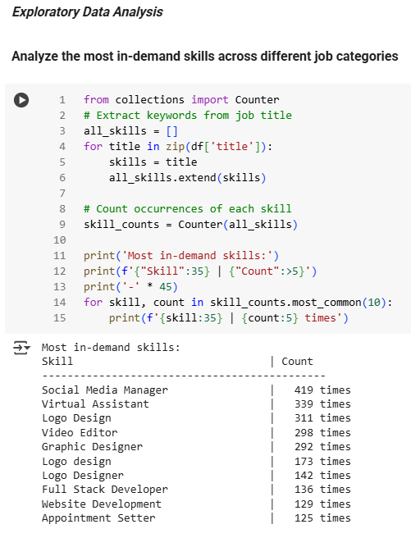
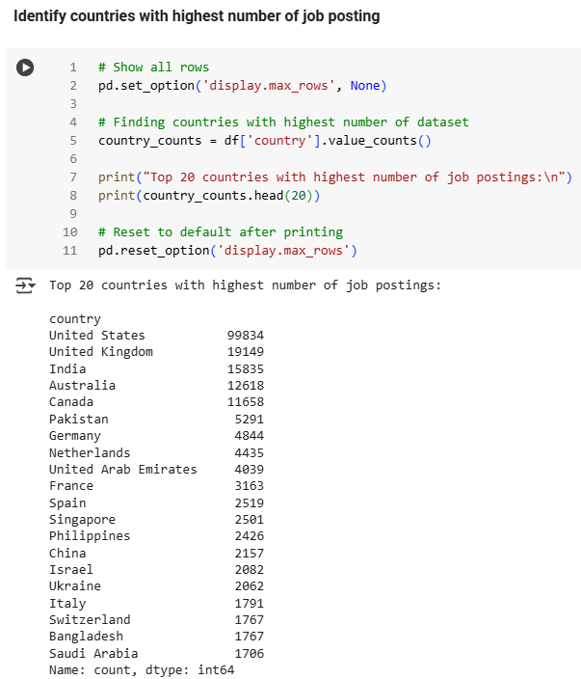


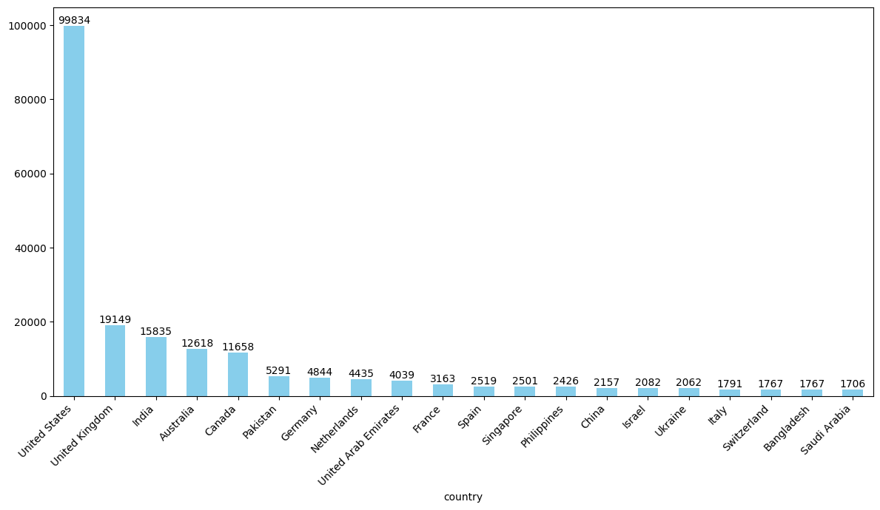

Task 1: EDA on Upwork Job Data
📦 Dataset Overview
Worked with 244,828 job postings from Upwork (Feb–Mar 2024)
Cleaned missing data in fields like budget and hourly rate
Converted published_date to datetime format for trend analysis
🛠️ Skill Keyword Extraction
Extracted keywords from job titles to find trending skills
Found repeated terms mostly in tech, writing & digital marketing
Currently rule-based; can improve with NLP or embeddings
🌍 Top Job-Posting Countries
Grouped jobs by country to find where most roles come from
Top 5 Countries:
🇺🇸 USA – 99,834 jobs
🇬🇧 UK – 19,149
🇮🇳 India – 15,835
🇦🇺 Australia – 12,618
🇨🇦 Canada – 11,658
🇺🇸 USA clearly dominates the platform

Slide 3
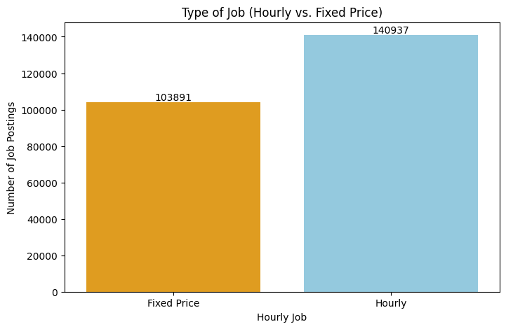
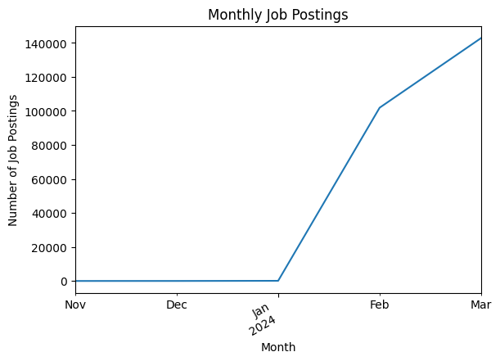
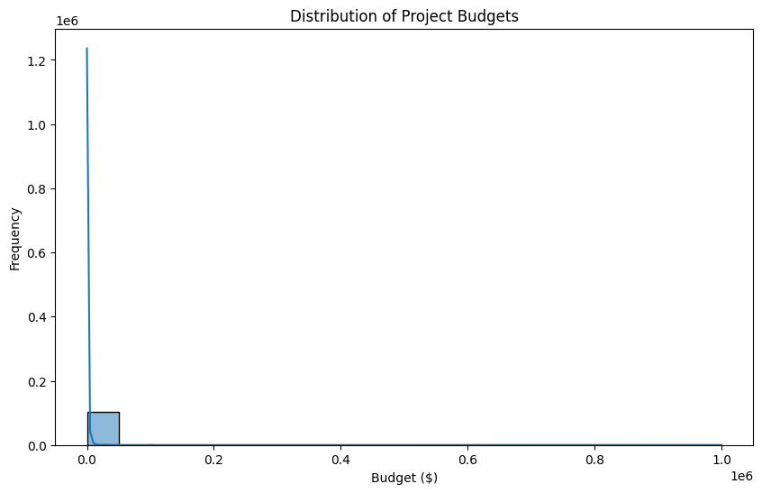
Task 1: Key Insights & Early Prototype
1
⏳ Hourly vs Fixed Price Jobs
Compared job types based on payment model
✅ Fixed-price jobs were slightly more common than hourly
Shows clients prefer pay-per-project structure
2
💸 Budget Distribution
Most job budgets are low to moderate
A few very high budgets created skewed visuals
Plan to apply outlier caps for better clarity next time
3
📅 Monthly Posting Trend
Grouped job posts by month to see job flow
Created line charts to show posting volume changes
Data is limited to 2 months, so trend scope is small
4
🤝 Basic Job Recommender (Prototype)
Built a simple system to match skills to jobs by title
Example: Input "Data Engineer" → returns all matching job titles
Early version worked well; can be improved using NLP techniques

Slide 4
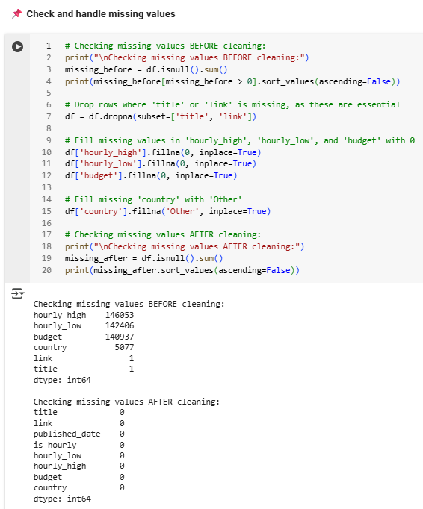
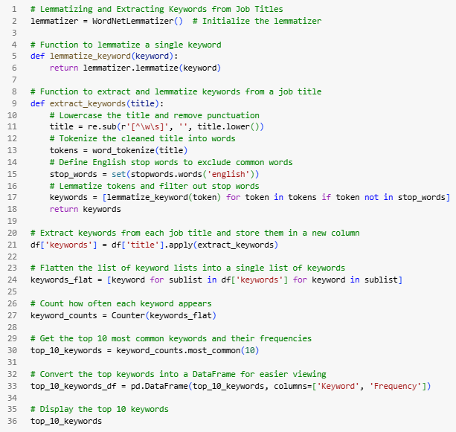
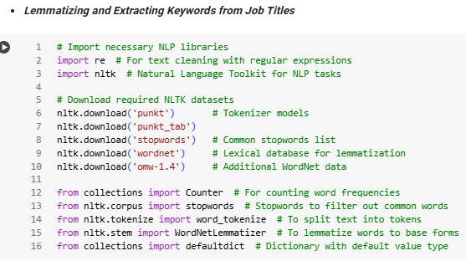
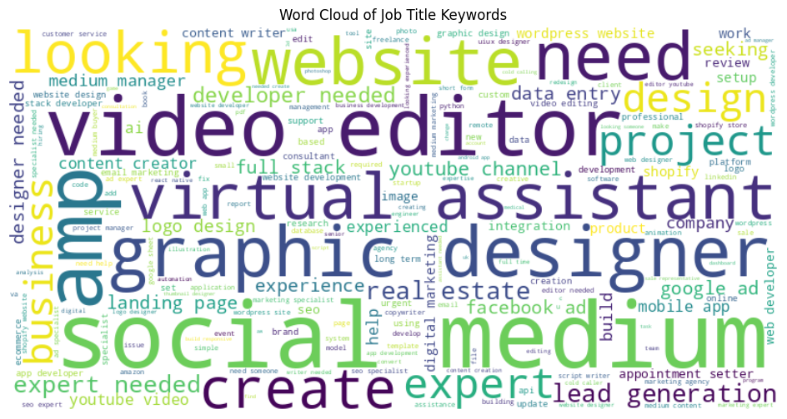
📊 Task 1 – Job Titles & Budget Analysis
01
✅ Missing Value Cleanup
Dropped rows with missing title or link — critical fields
Filled missing hourly_low, hourly_high, and budget with 0💰
Replaced blank country entries with 'Other’ 🌍
➡️ Result: No missing values left in the dataset! 😌
02
🔍 Keyword Extraction from Titles
Cleaned job titles using lemmatization and stopword removal
Extracted keywords and calculated frequency using NLTK + Python 🧠
Merged similar terms (e.g. "need" + "needed", "design" + "designer") for cleaner insights
📌 Top Keywords (Post-cleaning):
need – 28K+
design – 26K+
website, developer, expert, video, etc.
03
🌐 Word Cloud Snapshot
03
Built a Word Cloud to visualize the most frequent job-related terms
➡️ Offered a quick view of in-demand freelancing roles 💼💡

Slide 5
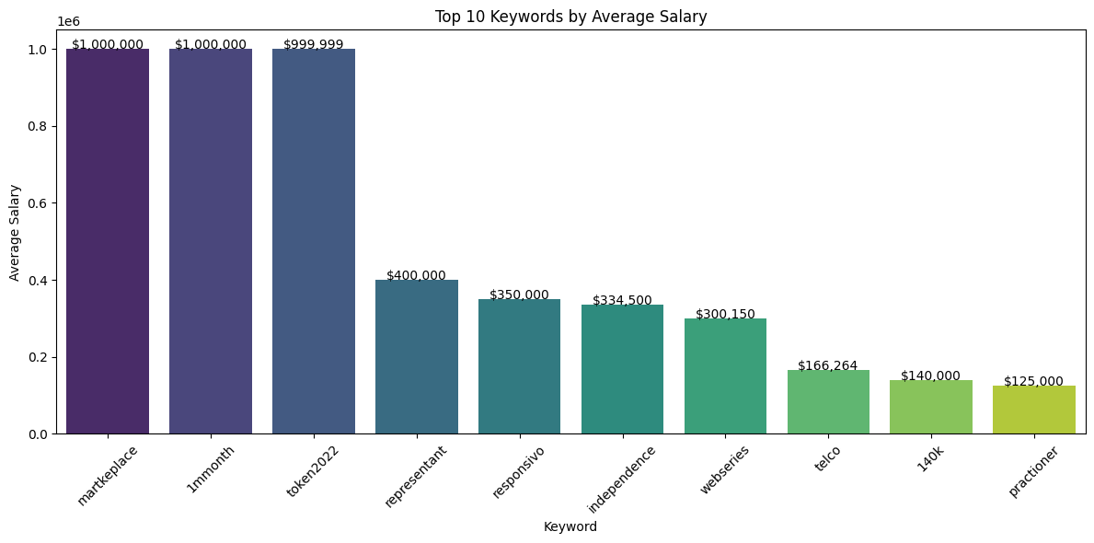
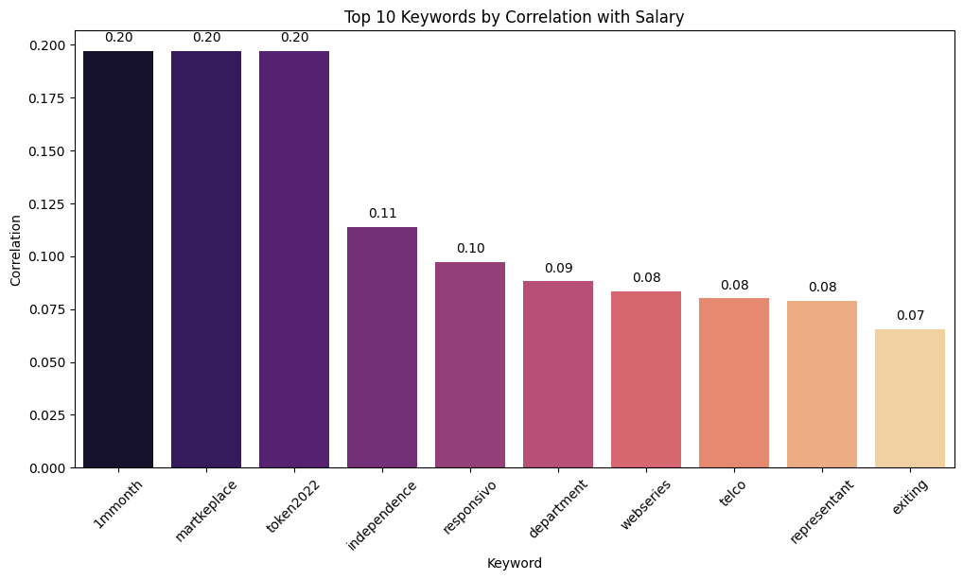
💸 Task 1 – Salary Insights from Keywords
💵 Top Keywords by Avg. Salary
Calculated average budget per keyword
Found that highest-paying keywords ≠ most frequent ➡️ Helped spot niche roles with higher value 🔍💰
01
📈 Keyword-Salary Correlation
Used MultiLabelBinarizer to create binary matrix for keywords
Applied Pearson correlation between keyword presence & budget
Found keywords with strong positive salary correlation ➡️ Indicates potential premium skills worth focusing on 🧠💼
02
🧠 Key Takeaways
Keywords like "developer", "design", and "expert" are popular
But niche keywords (less frequent) often pay more ➡️ Shows low-supply, high-demand opportunities in the freelance space
03

Slide 6
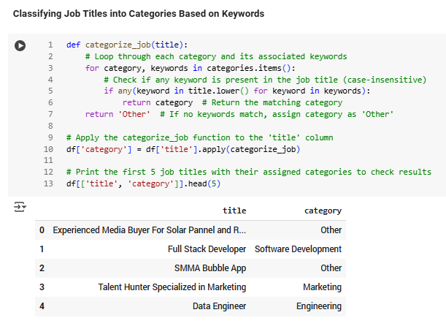
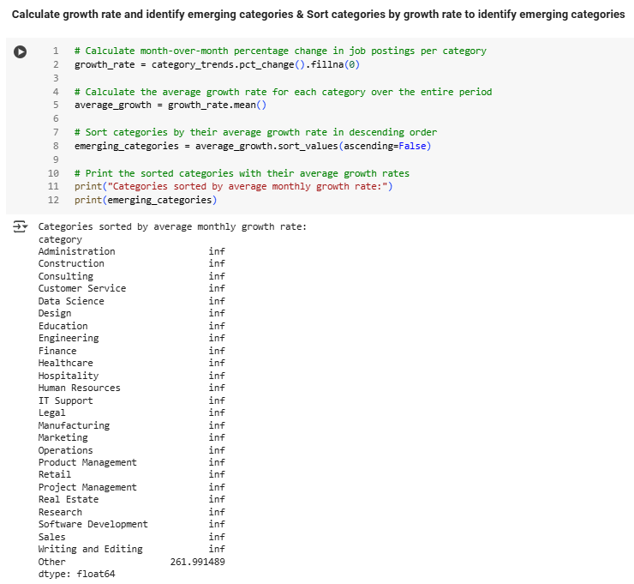
📌 Task 2 – Identifying Emerging Job Categories
01
🧹 Data Cleanup & Setup
Converted published_date to datetime
Created a new year_month column for monthly trend analysis 📆
🏷️ Job Categorization
Mapped job titles into categories like:
Data Science, Design, Consulting, Healthcare, etc.
Used custom keyword matching
Unmatched titles were labeled as 'Other' ✍️
02
03
📊 Monthly Job Posting Trends
Used .groupby() + .unstack() to reshape data for time-series analysis
Tracked job volume by category across months
04
📈 Growth Rate Calculation
Calculated month-over-month % change in job counts per category
Averaged growth to identify fastest-growing categoriess 🚀

Slide 7

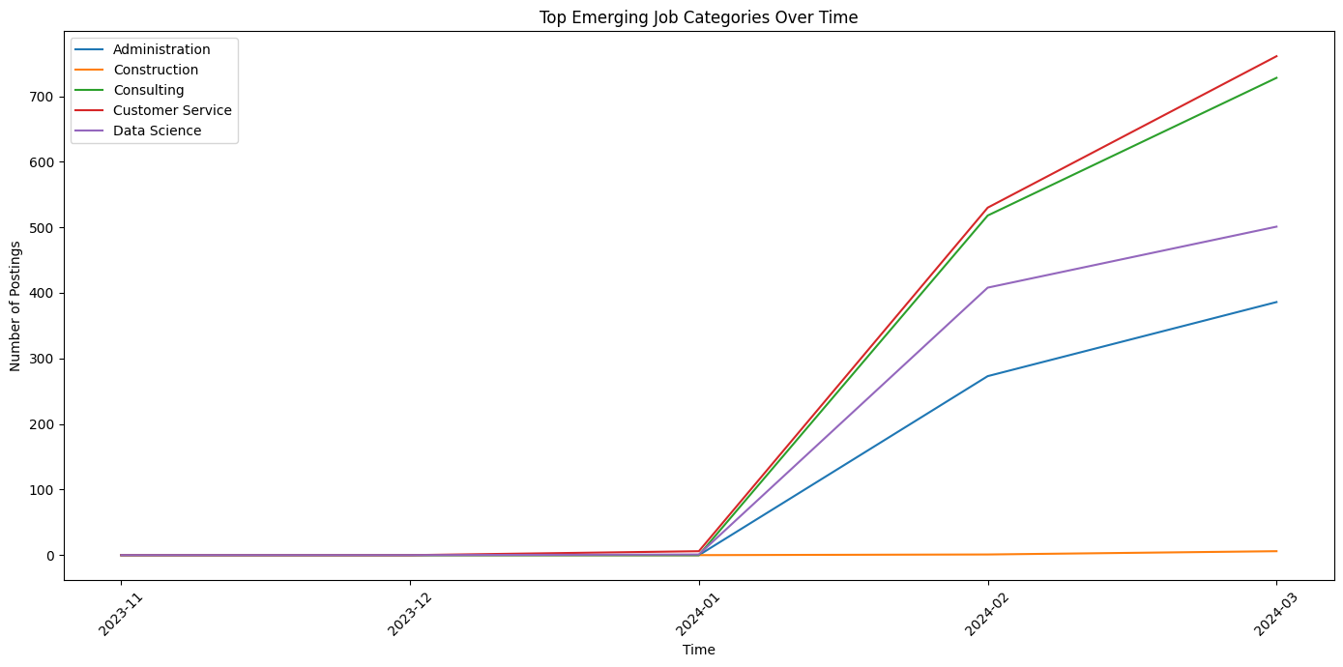
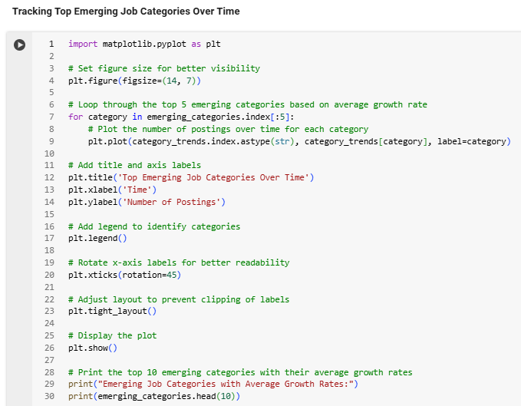
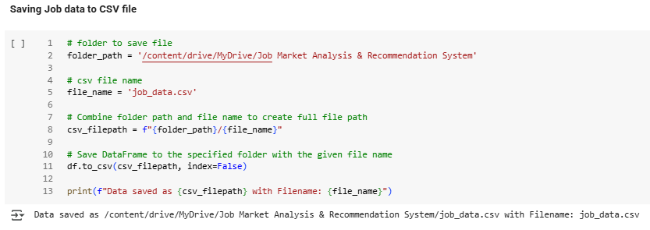
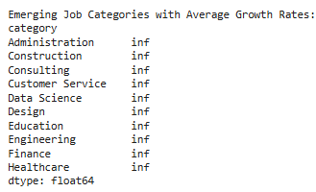
🔥 Key Insights & Emerging Categories
🌟 Top Emerging Categories (by Avg. Growth)
STEP
01
1️⃣ Administration | 2️⃣ Construction | 3️⃣ Consulting → inf ⚠️
4️⃣ Customer Service | 5️⃣ Data Science → inf ⚠️
⚠️ inf = No jobs earlier, new now → indicates strong upward trend
🖼️ Visualization
STEP
02
Line chart created to track top 5 growing categories
Showed fields like Data Science and Consulting rising steadily 🪜
📉 Caveats
STEP
03
Some spikes due to new categories appearing for the first time
Not all indicate consistent demand yet - but useful early indicators 🔍
💾 Final Step
STEP
04
Saved the cleaned and categorized dataset for future use
📁 /job_data.csv
✅ Summary
STEP
05
Discovered emerging job categories by tracking monthly trends
Fields like Data Science, Customer Service, Consulting show high momentum
Useful for platforms and recruiters to focus on upcoming demand areas 🔮

Slide 8
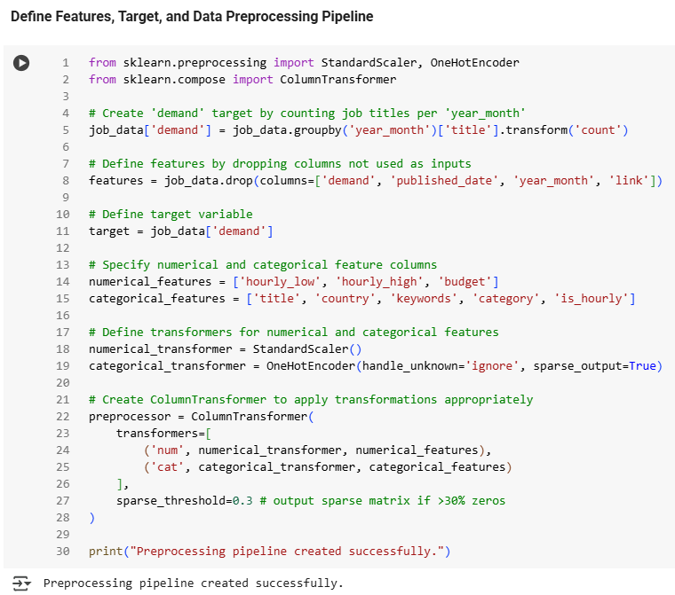
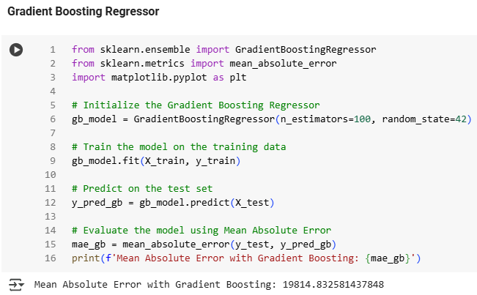
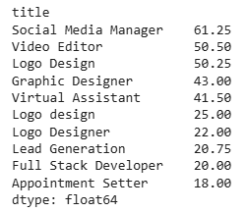
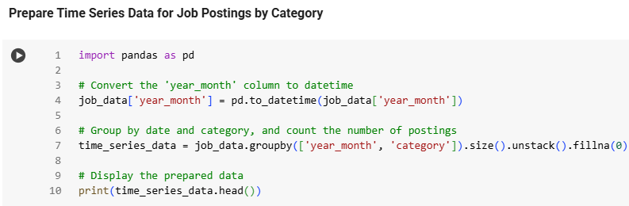
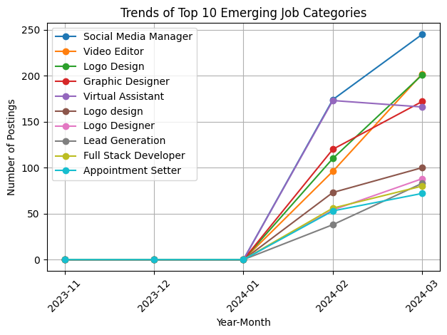
Task 3: Predicting High-Demand Job Roles | Forecasting & Insights
🛠️ Data Preparation
1
Extracted key fields: title, category, month
Created a target variable for monthly job demand
Applied scaling, encoding & dimensionality reduction for model training
🧩 Modeling
2
Trained a Gradient Boosting Regressor
Used MAE, MSE, and R² for evaluation ⚠️ Model performance was low due to data sparsity & noise
🦋 Trend Analysis
3
Analyzed job posting changes month-by-month
Identified Top 10 Emerging Job Titles based on growth:
✅ Social Media Manager | ✅ Video Editor | ✅ Logo Design | ✅ Graphic Designer
✅ Virtual Assistant | ✅ Content Writer | ✅ YouTube Manager | ✅ Personal Assistant ✅ Web Designer | ✅ Bookkeeper
📉 Time Series Forecasting
4
Applied exponential smoothing to predict future trends
Generated 12-month forecasts for each category 📌 Example: Data Science shows steady upward trend
Plotted forecasts to visualize emerging or seasonal demand
🔍 Key Insights
5
🧑‍💻 Creative + remote-friendly roles like → Social Media Manager and Virtual Assistant are rising fast
🧾 Steady demand remains for → Web Designers, Content Writers, and Bookkeepers
📊 Forecasts give job seekers and platforms → A clear view of what's trending and where to focus 🔮

Slide 9
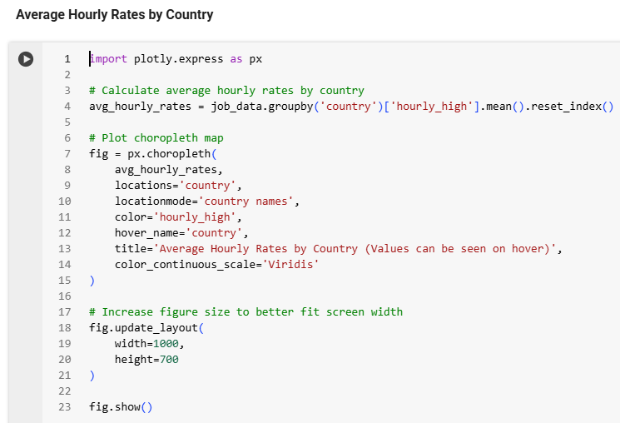
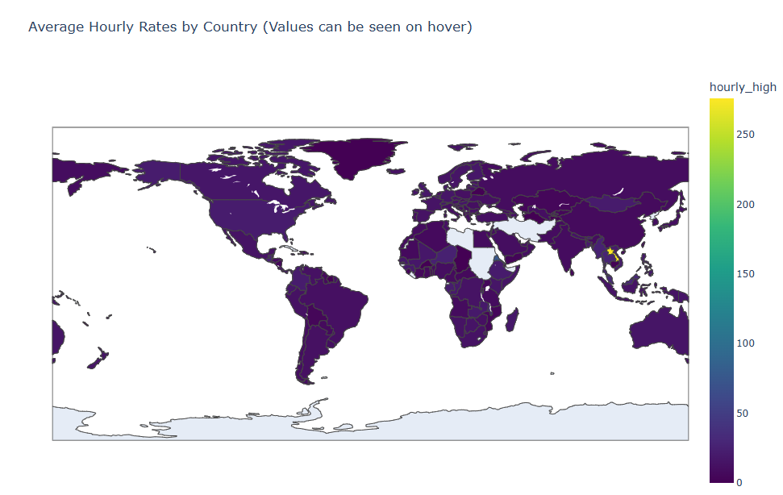
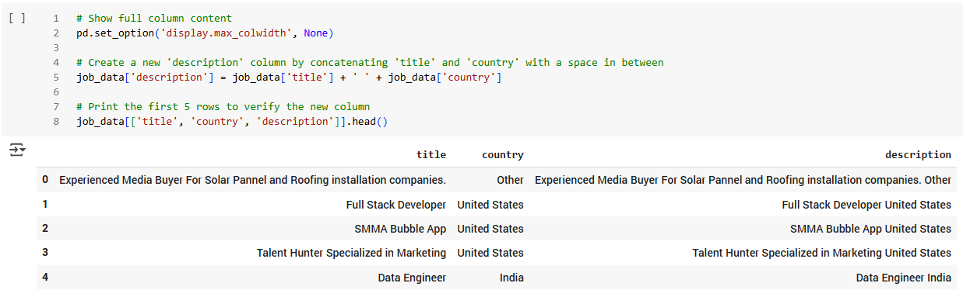
🌍 Task 4 – Exploring Hourly Rate Differences Across Countries
01
Objective
To explore how freelance hourly rates vary across countries & identify high-paying regions💰🌎
02
What I Did
Grouped jobs by country and calculated average of hourly_high
Built a choropleth map using Plotly Express to visualize global pay trends
Used Viridis colour scale for contrast and customized layout for clarity 🌈
Created a description field combining job title + country for future keyword-based tasks
03
Key Findings
🌟 Countries like Vietnam and Philippines showed surprisingly high average rates
🟣 Lower rates were common in India, Africa, and South America
🤖 Helped highlight regional pay disparities and where to target high-paying remote work
📍 Interactive map made it easy to explore hourly rates country-wise by hovering

Slide 10
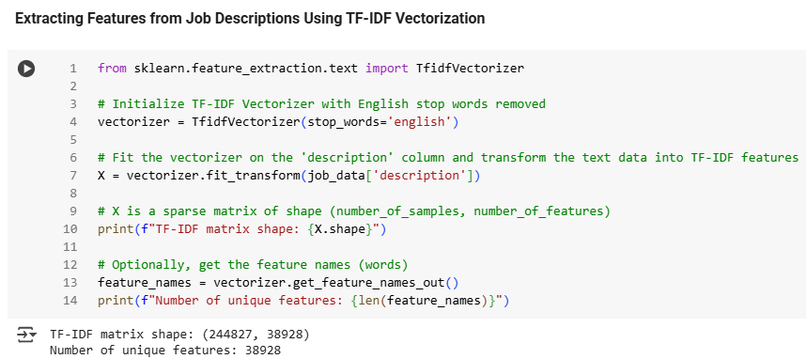

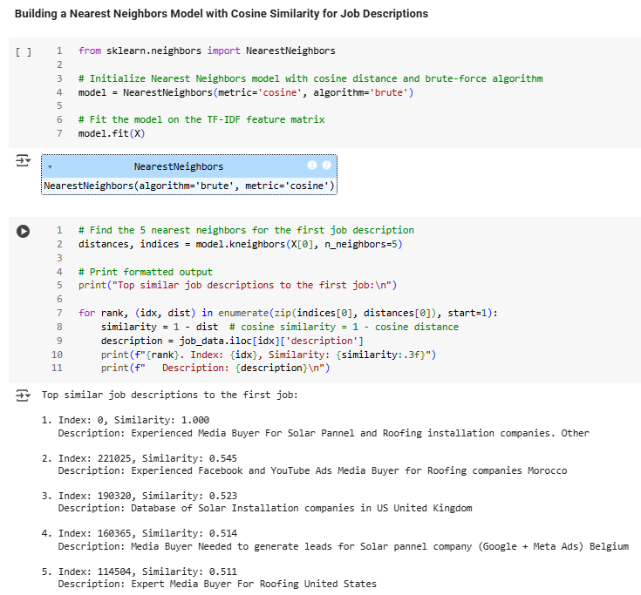

🤖 Task 5 – Job Similarity Recommendation Using TF-IDF & Cosine Similarity
🧹 Text Vectorization Using TF-IDF
🧼 Cleaned job descriptions and applied TF-IDF to highlight important terms
📚 Final matrix: 244,827 jobs × 38,928 features — showcasing rich textual variety
✂️ Removed common filler words (e.g., "the", "and") to focus on meaningful terms
🔍 Similarity Matching with Nearest Neighbors
🧠 Used cosine similarity with Nearest Neighbors to compare job descriptions
🔁 Retrieved top 5 most similar jobs for any given listing
📉 Lower cosine distance = higher similarity
🌍 Added a custom description field (title + country) for improved context
💾 Model Saving for Reuse
📦 Saved both TF-IDF vectorizer and Nearest Neighbors model using pickle
🔄 Enabled reusability without retraining — ideal for deployment or integration
📊 Performance & Output Insights
✅ Recommendations were accurate and relevant — cosine scores around 0.51–0.54
🌐 Similar jobs were found even across different countries with contextual overlap
⚡ Model is fast, scalable, and easy to interpret, even with 200K+ jobs
📍 Extracted full country list to support region-specific recommendations

Slide 11
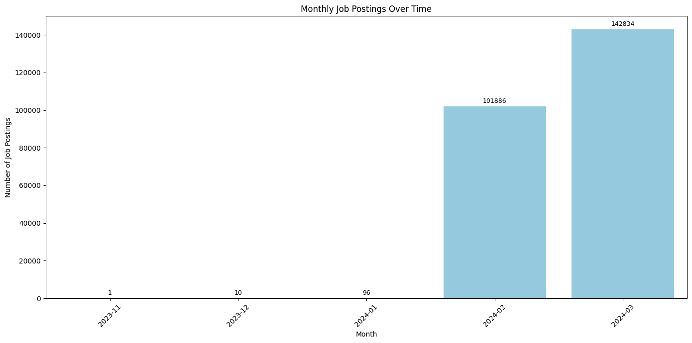
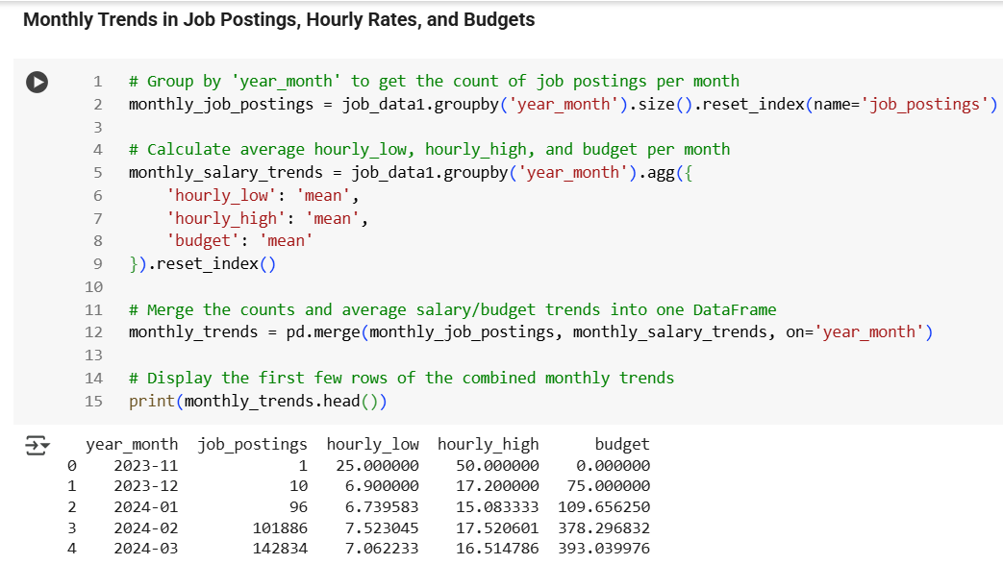
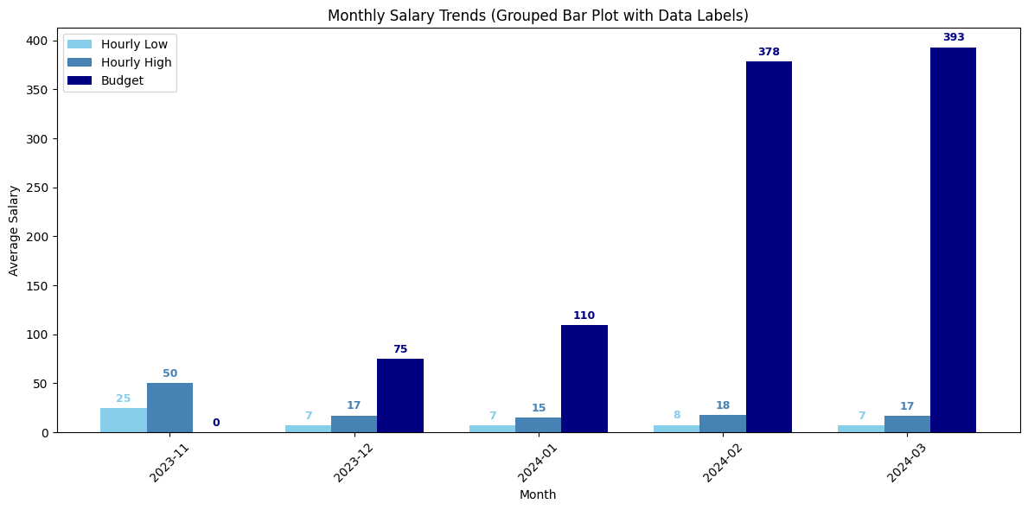
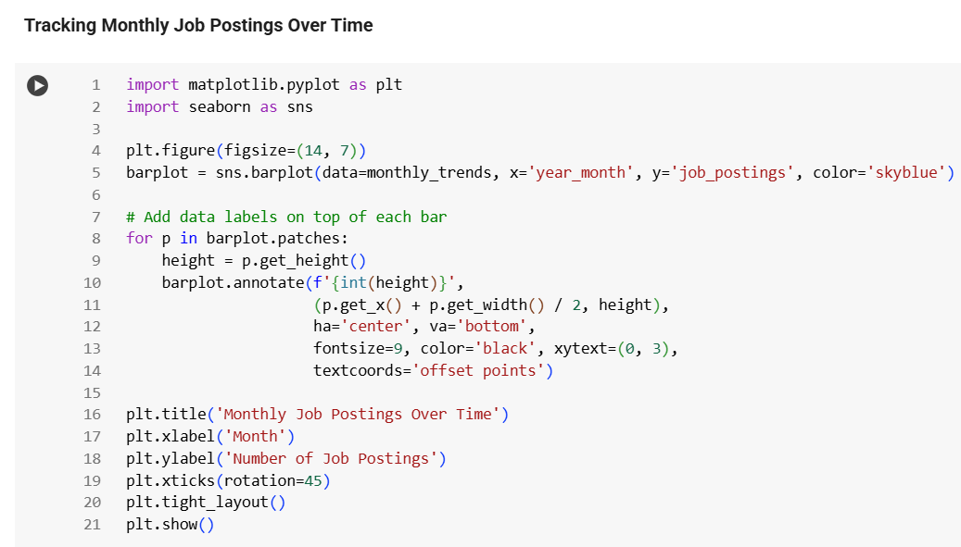
📊 Task 6 – Tracking Monthly Changes in Job Market Demand
👥 Most In-Demand Job Roles
Frequently posted roles include:
👨‍💻 Data Scientist | 📊 Data Analyst | 🤖 ML Engineer | 💼 Business Analyst
Highlights a strong industry focus on data-driven roles
01
📈 Overall Growth in Job Postings
Observed a steady rise in job volume month-over-month 📅
Suggests rising demand for skilled professionals
Driven by 📦 digital adoption, 🤖 AI/ML integration & 📊 data-first strategies
02
⚙️ High Demand for Technical Skills
Most roles require:
🐍 Python / R | 🧠 Machine Learning | 🧮 SQL | 📊 Power BI / Tableau
Shows strong demand for analytical & programming expertise.
03
📆 Seasonal Fluctuations Noted
Despite the growth, up-and-down patterns appear over months
Likely caused by:
🔁 Quarterly hiring cycles | 💰 Budget approvals | 🚀 Project kick-offs
04
🎯 Guidance for Job Seekers To Focus On
✅ In-demand roles & tools
🔍 Staying updated on job market trends
📚 Practicing real-world tech skills
05

Slide 12
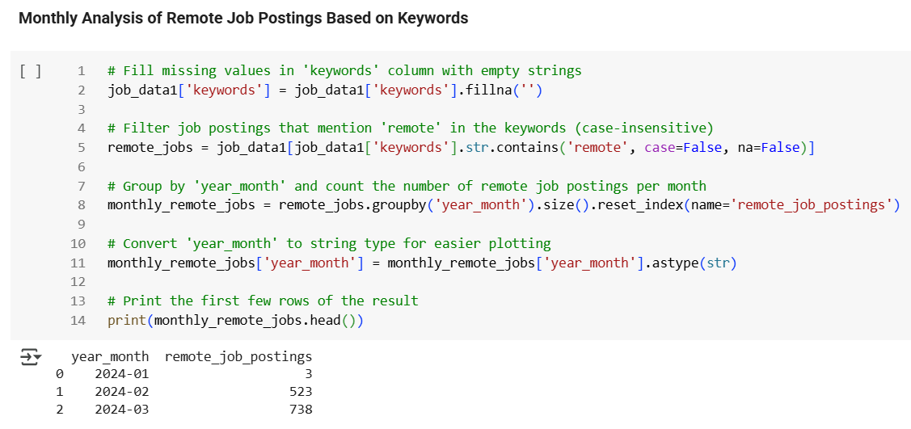
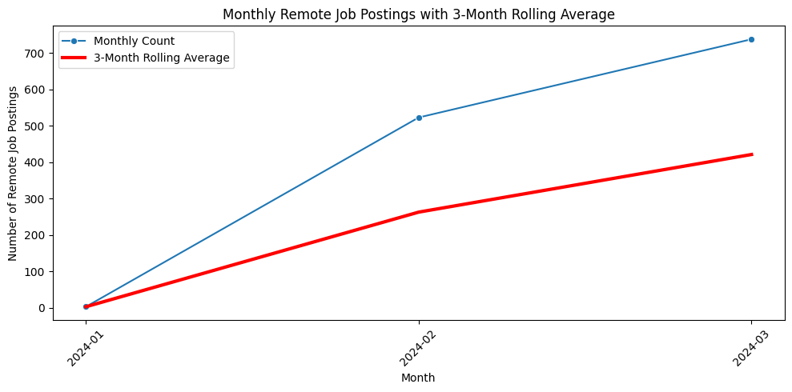
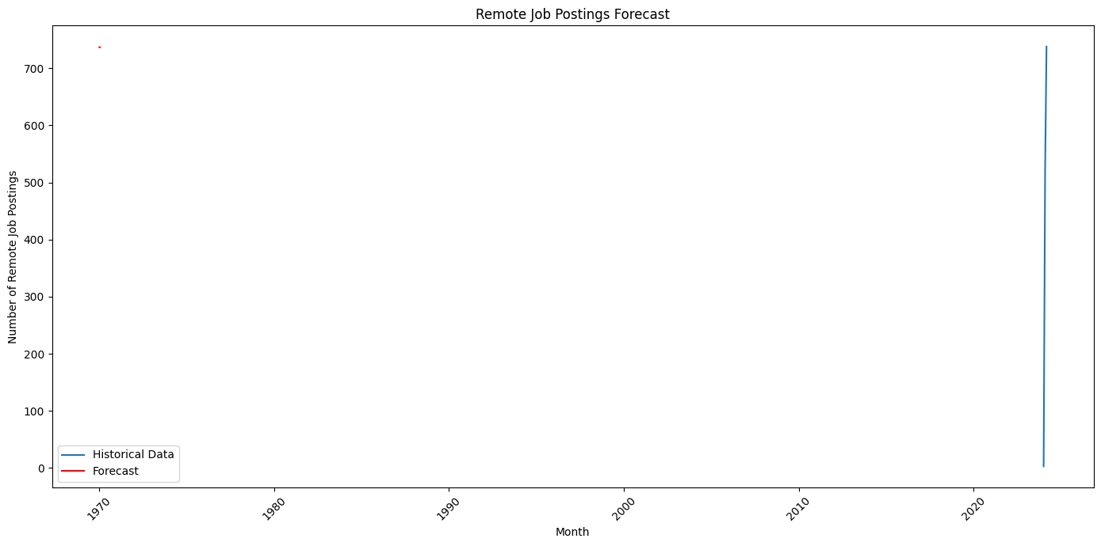
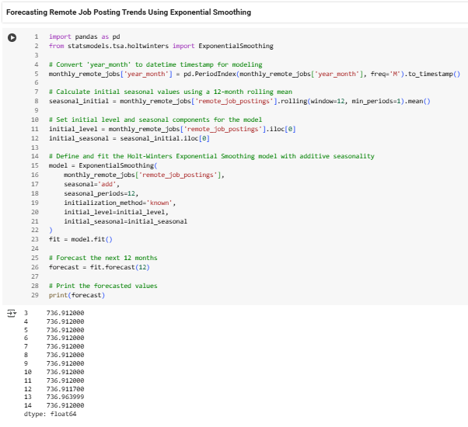
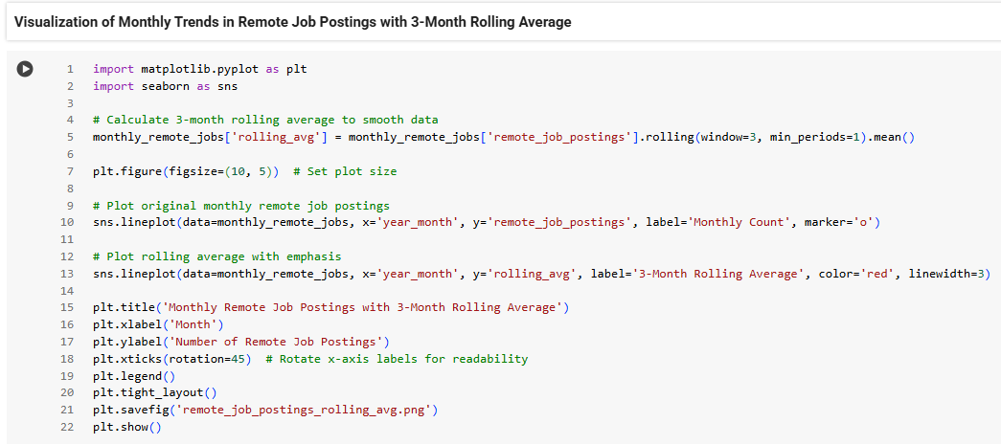
🏠 Task 7 – Remote Work Trends Analysis Using Rolling Average & Forecasting
📈 Surge in Remote Job Postings
01
🚀 Remote jobs increased from 3 in Jan to 738 in Mar 2024
📢 Proves remote work is quickly rising in popularity
02
📊 Rolling Average Reveals Consistent Growth
📉 Applied a 3-month rolling average to smooth out spikes
📈 Clearly shows a steady upward momentum in demand
03
🔮 Forecast Indicates Stable Future Demand
📅 Used Exponential Smoothing to predict next 12 months
🔁 Remote job postings likely to stay above 736/month
04
📅 Shift in Job Market Behaviour
⚡ Compared to early months, demand shows rapid change
🏠 Remote flexibility is now a mainstream hiring norm

Slide 13
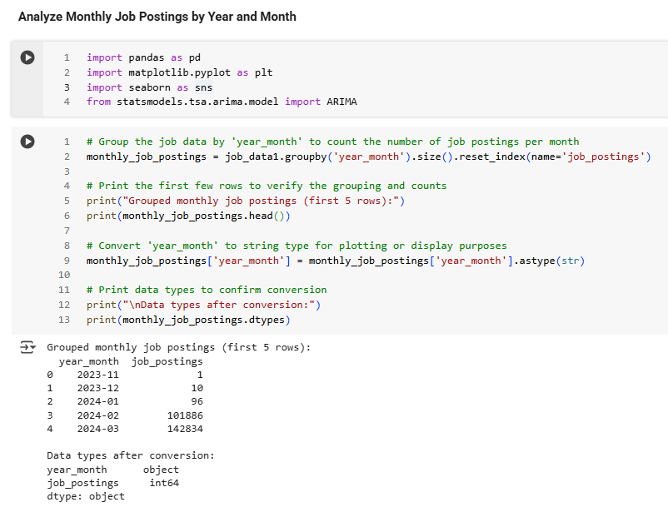


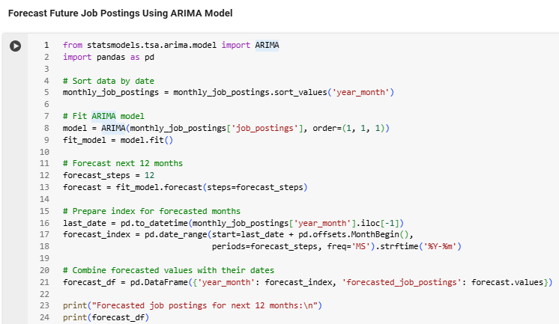
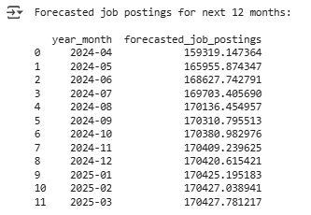


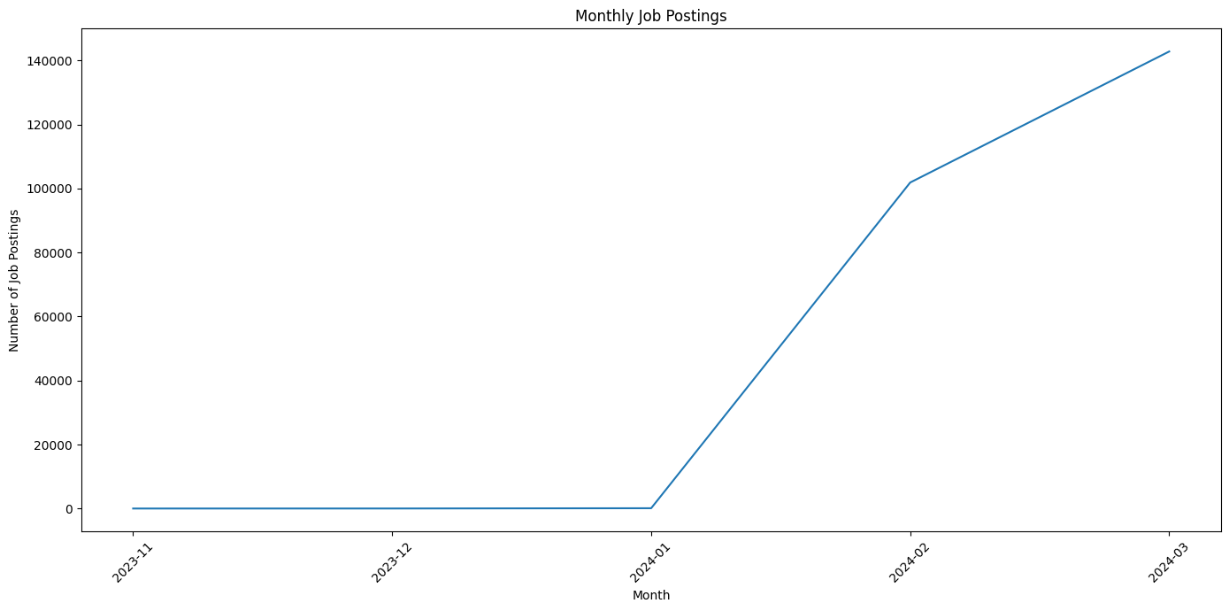
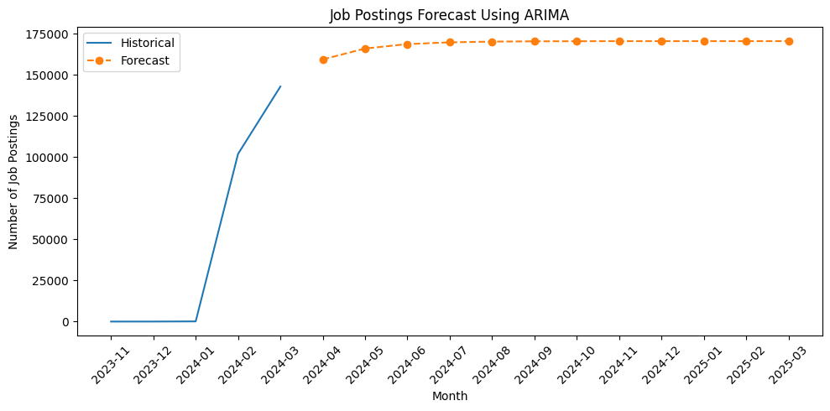

📊 Task 8 – Analyzing Overall Job Market Trends & Forecasts
🚀 Huge Spike in Q1 2024
📅 Job postings surged in Feb (101K) and Mar (143K)
💼 Indicates high hiring demand after a quiet quarter
📉➡️📈 Sharp Recovery from Zero Activity
❄️ Nov 2023 to Jan 2024 had near-zero postings
🔁 Feb 2024 brought a strong market rebound — likely seasonal
🌤️ Future Forecast – Growth Then Stability
📈 ARIMA model shows growth until July 2024 (~170K)
📊 After that, job volume plateaus, showing market stabilization
🔮 Forecast Shows High Confidence
📉 Forecast trend is smooth, not volatile
🧠 Suggests market is entering a mature, stable phase
📆 Seasonality Influences Hiring Patterns
📌 Spike aligns with post-holiday budgets & hiring cycles
🛠️ Future trend looks like steady, strategic hiring

Slide 14
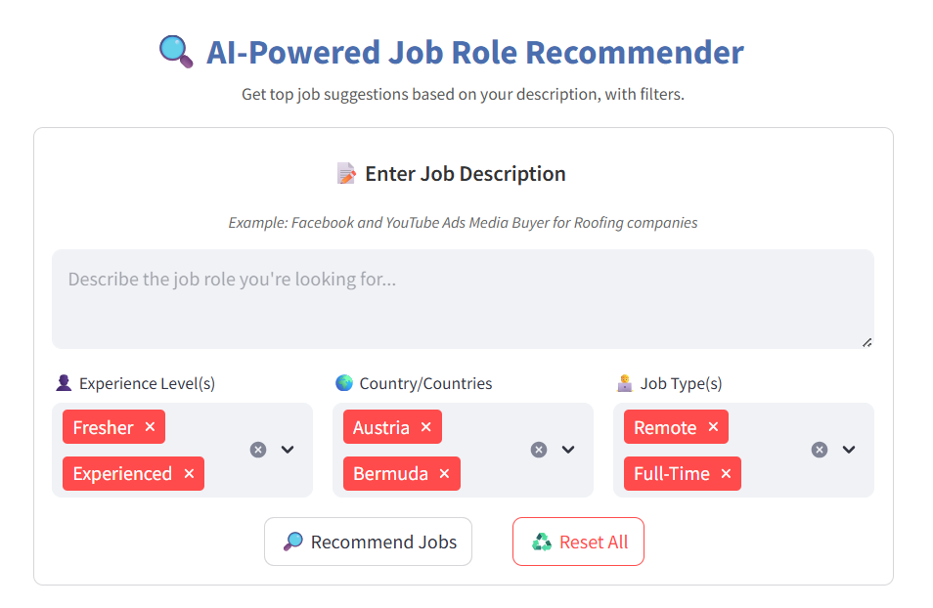
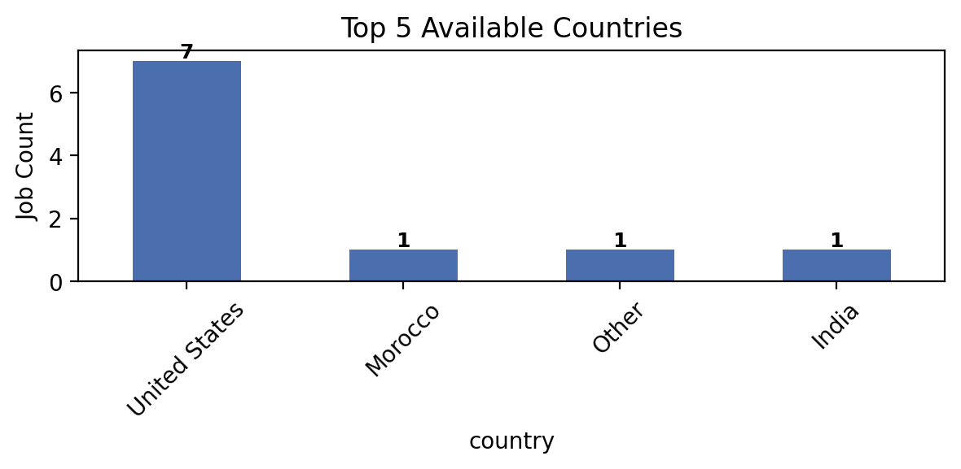
Building the Streamlit-Based Job
Recommendation System
🛠️ End-to-End App Functionality
Built an AI-powered job recommender app using Streamlit
Accepts a user-entered job description and returns top matching jobs
Allows filters for:
👤 Experience level (Fresher / Experienced)
🌍 Country
🧑‍💻 Job type (Remote, On-site, Freelance, etc.)
🔍 Recommendation Logic
🧠 Vectorized input using a pre-trained TF-IDF model
🗂️ Compared against 240K+ job descriptions using cosine similarity
🔟 Returned top 10 most similar roles ranked by match percentage
✨ Used highlighted keywords to show why a job was recommended
📦 Used a Nearest Neighbors model, loaded via pickle for efficiency
🧾 Data Handling & Preprocessing
🧹 Cleaned the dataset by filling missing values and creating extra fields
🌍 Merged job title + country into a single description field for better context
🔧 Handled missing fields like experience, job_type and keywords smoothly
❌ App shows an error and stops if the model or data isn’t available

Slide 15
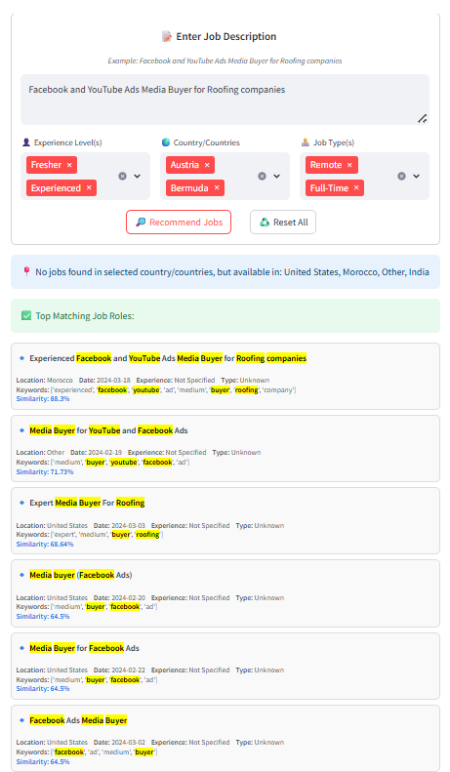
Output Features & User Experience of the Streamlit App
🔗 Live Streamlit App: App Link
🎥 All About My App: Video Link
📊 Output Visualization
Displays job matches with:
🔹 Highlighted titles
📍 Location, Experience, Type, and Posting Date
🔢 Similarity score in %
Results are styled for readability and scrollable exploration
01
🌐 Top Country Insights
⌛Extracted and visualized top 5 countries with most matching jobs
📈 Used Matplotlib bar chart for a clean and clear overview
02
📥 PDF Report Generation
Added a feature to download results as a PDF:
🗂️ Job title, location, experience, job type
🧾 Keywords and similarity %
Styled with FPDF for clear formatting and readable output
03
⚡ Final Highlights
✅ Real-time filtering, smart recommendations, and export-ready results
🧠 Fast, interpretable, and scalable solution for large job datasets
💾 All resources (model, vectorizer, dataset) loaded efficiently using caching
🚀 Offers a complete job search experience within a single app
04

Slide 16

Thank You!
Hope You find it helpful

